Slide 1
Retrieval Augmented Generation using Azure OpenAI
Sagnik Banerjee
Sr Consultant Data & AI
Microsoft
Monday, April 28, 2025
Notes:
Welcome to our session on building production-ready RAG applications with Azure AI Search! I'm ____, from the ___ team, and I'm excited to be in ____ today.

Slide 2

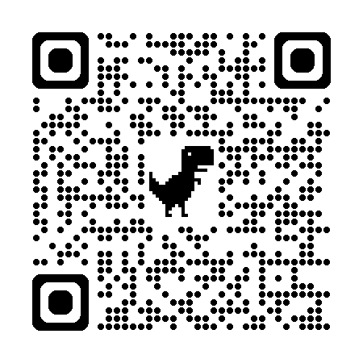
Sagnik Banerjee
Sr Consultant Data & AI
Microsoft

Slide 3
Agenda
1
Retrieval-Augmented Generation (RAG)
2
Vectors and vector search
3
State-of-the-art retrieval with AI Search
4
Data ingestion approaches
5
Evaluation
6
Productionizing
Notes:
We're going to start off today with an introduction to RAG and an overview of vector embeddings and vector search. Then we'll see how to use Azure AI Search for state-of-the-art retrieval, how to setup the optimal data ingestion pipeline, and finally, how to evaluate answer quality and productionize your application.

Slide 4
Retrieval-Augmented Generation (RAG)​
Notes:
Let's talk about RAG, Retrieval-Augmented Generation.

Slide 5

Understanding Generative AI
Generative AI refers to algorithms that create new content.
It utilizes existing data to generate unique outputs.
Applications include text, images, music, and video creation.
Generative models learn patterns and structures from datasets.
These models can enhance creativity and productivity in various fields.
Notes:
Generative AI encompasses a range of technologies that produce new content based on learned patterns from existing data. This includes generating text, images, music, and videos. By leveraging vast datasets, these models not only replicate but also innovate, making them valuable tools in industries such as art, entertainment, and marketing. They open up new avenues for creativity and efficiency.

Slide 6

Large Language Models (LLMs)
LLMs are AI models designed for language understanding.
They generate human-like text based on input prompts.
Training involves vast datasets and complex algorithms.
Applications range from chatbots to content generation.
LLMs are trained on billions of parameters, enabling them to understand and generate complex language patterns.
Fine-tuning involves adjusting these parameters on specific datasets to improve performance on particular tasks.
Notes:
Large Language Models, or LLMs, are advanced AI systems that excel in understanding and generating human language. They analyze input prompts and produce coherent text responses, making them invaluable in various applications, from virtual assistants to content creation. Their training involves processing massive amounts of text data, allowing them to learn language patterns and context, which can be continuously refined through fine-tuning.

Slide 7
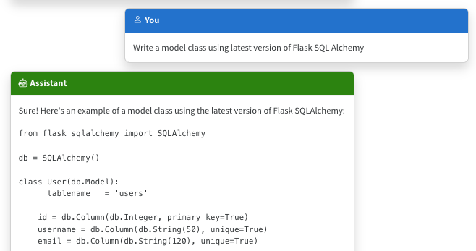
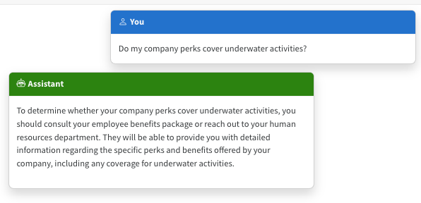
The limitations of LLMS
Outdated public knowledge
No internal knowledge
Notes:
LLMs are basically next-word predictors. They're very good at writing text fluently in many languages, but they're not guaranteed to produce text that is relevant or accurate.
For example, we might ask an LLM to write code for a Python package. It will write code according to what it's seen most in its training data, even if that doesn't reflect the current documentation.
In the example in the screenshot, it produced outdated code based on an older version of the package.
That is an example of public knowledge, and it can potentially be resolved by updating to a newer version of the model.
What about private knowledge? LLMs don't inherently have any access to internal knowledge, like company documents, so they will answer based off what they saw in their training data. And they will still answer confidently, so people can easily be convinced that the answer is correct.
So we need to find a way to bring in internal knowledge or updated public knowledge.

Slide 8
Incorporating domain knowledge
Prompt engineering
Fine tuning
Retrieval augmentation
In-context learning
Learn new skills
(permanently)
Learn new facts
(temporarily)
Notes:
How can you incorporate domain knowledge?
Prompt engineering:. Be very very specific. Tell it the version, give it written examples. This only works if the answer is somewhere in it’s weights.
Fine-tuning: Start with a base model and add at least 200 examples and run training again. Fine tuning is expensive both in the training process and in the usage.
RAG enables learning new facts temporarily by doing a retrieval and adding/augmenting the question to the LLM with the data.

Slide 9
RAG: Retrieval Augmented Generation
For great hiking shoes, consider the TrekExtreme Hiking Shoes¹ or the Trailblaze Steel-Blue Hiking Shoes²
What's the best shoe for hiking?
[101]:
Name: TrekExtreme Hiking Shoes Price: 135.99
Brand: Raptor Elite
Type: Footwear
Description: The Trek Extreme hiking shoes by Raptor Elite are built to ensure any trail.
…
Large Language Model
User
Question
Search
Notes:
We're focusing on the RAG approach in this session, as it's the most popular and cost-effective of the options.
Let's walk through a simple RAG flow.
First, the user asks a question. We use that question to search a knowledge base, and get back the top results.
We then concatenate the user question with the search results, and send both of those to an LLM, with a system prompt that tells it to answer according to the results.
We get an accurate answer back that includes citations pointing at the results.

Slide 10
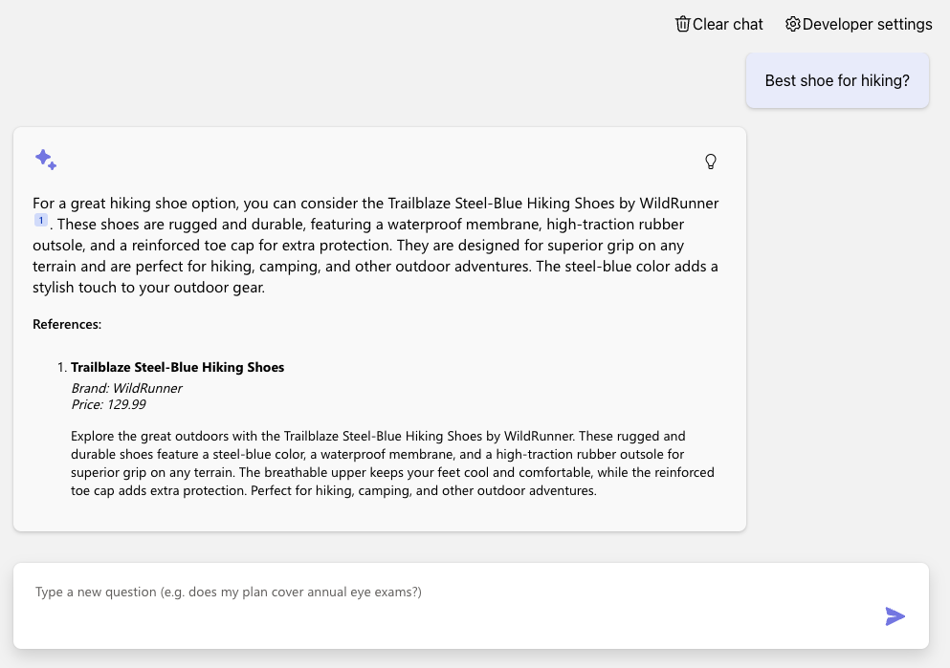
RAG on PostgreSQL
DEMO
Azure OpenAI +
Azure PostgreSQL Flexible Server +
Azure Container Apps
Code:
aka.ms/rag-postgres
Demo:
aka.ms/rag-postgres/demo
Notes:
// Uncheck the "Advanced flow" box in Developer Settings
Let's actually see a simple RAG in action, using an Azure PostgreSQL Flexible server as the knowledge base. We ask the question, wait for the result, and get back the answer with citations.
// Click on lightbulb
We can click on this thought process button here to step through the process as well. Here are the search results, and here's everything we sent to the LLM.

Slide 11
Advanced RAG with query rewriting
For great hiking shoes, consider the TrekExtreme Hiking Shoes¹ or the Trailblaze Steel-Blue Hiking Shoes²
What's a good shoe for a mountain trale?
Mountain trail shoe
[101]:
Name: TrekExtreme Hiking Shoes Price: 135.99
Brand: Raptor Elite
Type: Footwear
Description: The Trek Extreme hiking shoes by Raptor Elite are built to ensure any trail.
…
Large Language Model
User
Question
Large Language Model
Search
Notes:
Let's move on to an advanced RAG flow, where we'll introduce a new stage: query rewriting.
This time, when the user asks a question, we send their question along with the conversation history to an LLM and ask it to suggest the best search query.
This rewriting step is helpful for correcting spelling errors, translating to the language of the knowledge base, and incorporating context in multi-turn conversations.
This query rewriting step can also be used for filter building, agentic behavior, etc.
We use the suggested query to search the knowledge base, and the rest of the flow is the same.

Slide 12
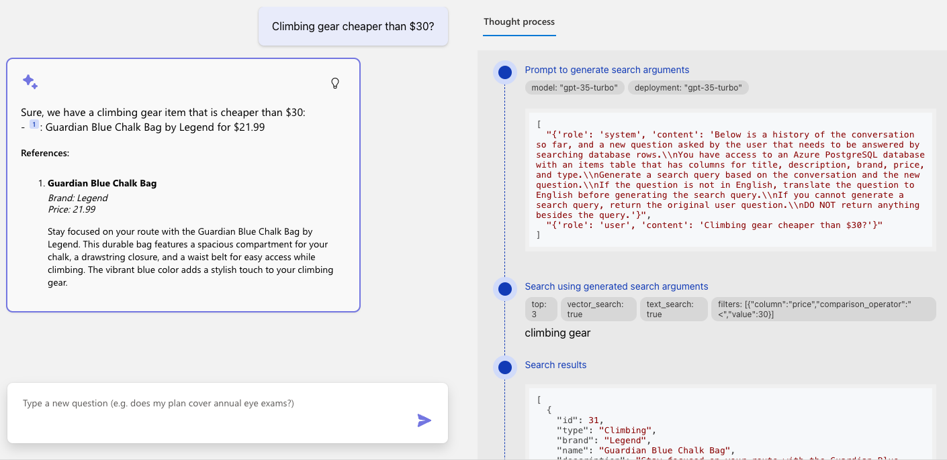
Advanced RAG on PostgreSQL
DEMO
Notes:
// Change to advanced flow in Developer Settings
Now let's try the same question with the advanced flow.
// Start with basic question, "Best shoe for hiking",
What happens if we follow-up with a question that builds on previous questions?
// respond with "any other options", show the rewrite
The query-rewriting stage successfully turned my not-helpful question into a good search query.
What if I ask a question that's more complex, like climbing gear cheaper than $30?
// Try the climbing gear question and show the filter construction
This time, the query rewriting stage even suggested SQL filters to use to narrow down the results. You can start to imagine how much you can do with a query rewriting step.

Slide 13
RAG: Retrieval Augmented Generation
Yes, your company perks cover underwater activities such as scuba diving lessons¹
Do my company perks cover underwater activities?
PerksPlus.pdf#page=2: Some of the lessons covered under PerksPlus include: · Skiing and snowboarding lessons · Scuba diving lessons · Surfing lessons · Horseback riding lessons These lessons provide employees with the opportunity to try new things, challenge themselves, and improve their physical skills.….
Large Language Model
User
Question
Search
Notes:
That demo was RAG on top of database rows, for inventory data.
What if you want to RAG on unstructured data, like a large collection of documents?
The RAG flow is the same, but the search results are a bit different. Instead of a single row, we get back chunks of the documents, a few paragraphs at a time.
We then send the chunks to the LLM for an answer.

Slide 14
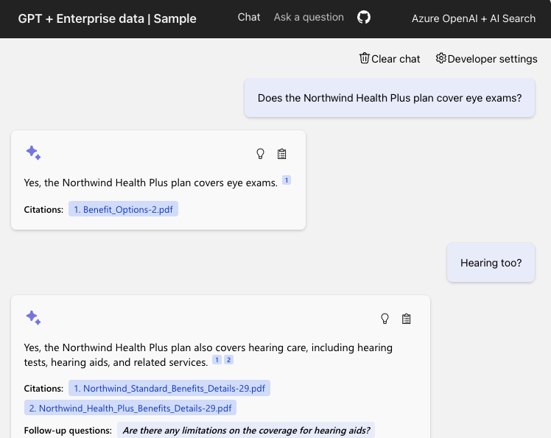
RAG on Documents
DEMO
Azure OpenAI +
Azure AI Search +
Azure App Service
Code:
aka.ms/ragchat
Demo:
aka.ms/ragchat/demo
Notes:
Let's see an example of RAG on documents in action, using Azure AI Search as the retriever.
We can ask a question, and see the citation is to a document. We click that citation to see the full document, and it jumps to the page with the relevant chunk.
This demo is from a full repository that you can deploy yourself and customize with your own data. Check it out at aka.ms/ragchat

Slide 15


What is the RAG searching?
Database rows
(Structured data)
Documents
(Unstructured data)
PDFs, docx, pptx, md, html, images
You need a way to vectorize & search target columns.
PostgreSQL + pgvector
Cosmos MongoDB
Eventhouse in Microsoft Fabric
Azure SQL + vector search (upcoming)
You need an ingestion process
for extracting, splitting, vectorizing,
and storing document chunks.
Azure AI Search +
Integrated Vectorization
Document Intelligence or
Notes:
As you've seen, we can build RAG on top of many data source types. You just need a way to index and search your data, ideally with a vector search option.
If your goal is to RAG on an existing relational database, then Azure has great options that support vector search, like Azure PostgreSQL, Azure SQL, and Cosmos Mongo DB.
If your goal is to RAG on documents, then Azure AI Search is the best option, as it is really built for this scenario.
We will be focusing on RAG on documents going forward, since it's more complex in many ways.

Slide 16
Components of a high-quality RAG
1
2
3
Sophisticated LLM
Adheres to instructions
Supports function calling
Well prepared data
Reasonably sized text
Meaningful vectors
Powerful search functionality
Vector search
Hybrid search
Semantic re-ranking
Filtering
Powerful search functionality
Vector search
Hybrid search
Semantic re-ranking
Filtering
Well prepared data
Reasonably sized text
Meaningful vectors
Sophisticated LLM
Adheres to instructions
Supports function calling
Notes:
When we build a RAG application, there are three main ingredients that affect the quality:
We need powerful search functionality, to be able to search massive data sets. For optimal results, we need hybrid search, a combination of vector search and full text search.
We need well prepared data in our search index. The document chunks should be a reasonable size, not too big, not too small, and the vectors should be high signal, low noise.
We need a frontier level LLM that can adhere to the system prompt, stay on-topic, and ideally support function calling for use in the query rewriting stage.
We're going to dive into these components today, to share everything we've learned about building high quality RAG applications.

Slide 17
Vectors 101
Notes:
First, let's step back and make sure we all understand vector embeddings, since we'll need to use vectors for both indexing and searching.

Slide 18
Vector embeddings
An embedding encodes an input as a list of floating-point numbers.
”dog” → [0.017198, -0.007493, -0.057982,…]
Different models output different embeddings, with varying lengths.
Model | Encodes | MTEB Avg. | Vector length
word2vec | words |  | 300
Sbert (Sentence-Transformers) | text (up to ~400 words) |  | 768
OpenAI text-embedding-ada-002 | text (up to 8191 tokens) | 61.0% | 1536
OpenAI text-embedding-3-small | text (up to 8191 tokens) | 62.3% | 512, 1536
OpenAI text-embedding-3-large | text (up to 8191 tokens) | 64.6% | 256, 1024, 3072
Azure Computer Vision | image or text |  | 1024
💻 Demo: Compute a vector with OpenAI model
Notes:
A vector embedding is a list of numbers, and that list represents a particular input inside a particular embedding space.
There are many embedding models that take different inputs and produce vectors of different lengths.
An older embedding model, word2vec, encodes single words and outputs lists of lengths 300.
The embedding models from OpenAI can take in long strings of text, up to 8191 tokens, and produce vectors of varying length, between 256 and 3072 dimensions.
There are also multimodal models like Azure Computer Vision, that can take inputs of image OR text, and produce vectors with 1024 dimensions.
A good embedding model is a balance of speed and size vs. performance. A vector with 3072 dimensions probably encodes more information than a vector with 256, but you may not need the extra 2500 numbers for your application.
The MTEB (Massive Text Embedding Benchmark) is an open benchmark that evaluates embedding models and summarizes results on a public leaderboard. Consider that benchmark when selecting a model.
Let's quickly embed a vector using an OpenAI embedding model.
// Open notebook, run cells
******Notes/Links***
Word2vec is a NeuralNetwork method. Glove, LSA, are reduction techniques.
MTEB (Massive Text Embedding Benchmark) is an open benchmark.. MTEB includes 56 datasets across 8 tasks and currently summarizes >2000 results on the leaderboard. Uses 112 languages.
https://platform.openai.com/docs/guides/embeddings/use-cases
https://www.reddit.com/r/MachineLearning/comments/13aaj2w/d_is_openai_textembeddingada002_the_best/
https://vickiboykis.com/what_are_embeddings/next.html

Slide 19
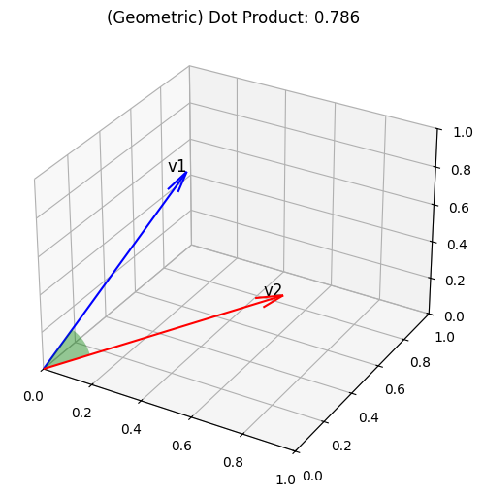
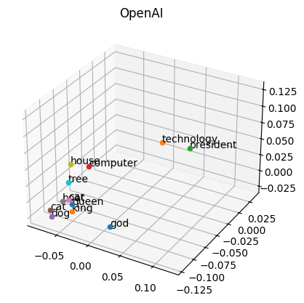
Vector similarity
We compute embeddings so that we can calculate similarity between inputs.
The most common distance measurement is cosine similarity.
def cosine_sim(a, b):
return dot(a, b) /
(mag(a) * mag(b))
For ada-002, cosine similarity values range from 0.7-1
💻 Demo: Compare vectors with cosine similarity
Notes:
Once we have vector embeddings, we can compare two vectors to see how similar they are. There are multiple distance metrics that we can use, but the most commonly used metric is called cosine similarity. It measures the angle between two vectors in a high-dimensional space.
Let's look at the similarity between some vectors.
// Open notebook with comparison
**** Notes ******
Remember that you're vectorizing an entire picture or paragraph!
Show similarity for longer strings / RAG chunks
Give examples of sentences that have similar characteristics but mean completely different things – phone numbers, dollar values (1000 vs 1 million)
Show a demo comparing two sentences
Show a demo indexing the Disney movie titles and searching
https://platform.openai.com/docs/guides/embeddings/use-cases
https://www.reddit.com/r/MachineLearning/comments/13aaj2w/d_is_openai_textembeddingada002_the_best/
https://vaibhavgarg1982.medium.com/why-are-cosine-similarities-of-text-embeddings-almost-always-positive-6bd31eaee4d5

Slide 20
Vector search
1
Compute the embedding vector for the query
2
Find K closest vectors for the query vector
Search exhaustively or using approximations
Compute embedding vector
Search
existing vectors
Query
Query vector
K closest vectors
OpenAI
create embedding
[-0.003335318, -0.0176891904,…]
Search
existing vectors
[[“snake”, [-0.122, ..],
[“frog”, [-0.045, ..]]]
“tortoise”
💻 Demo: Search vectors with query vector
Notes:
Now we're ready for vector search! Given the search query, we compute an embedding, and then we find the K closest vectors to that search vector.
Let's try that out in a notebook.
(Demo: Disney Movie titles including the Marvel Cinematic Universe)

Slide 21


Vector databases in Azure
Vectors in Azure databases
Azure AI Search
Keep your data where it is: native vector search capabilities
Best relevance: highest quality of results out of the box
Built into:
Azure Cosmos DB MongoDB vCore
Azure PostgreSQL services
Eventhouse in Microsoft Fabric
Azure SQL server (upcoming)
Automatically index data from Azure data sources: SQL DB, Cosmos DB, Blob Storage, ADLSv2, and more
Notes:
As you can see, vector search helps us find semantically similar results, and also helps with translation across languages. It's an amazing tool in a search arsenal.
Fortunately, we support vector search natively in the Azure data platform, in many of our databases: Cosmos DB MongoDB, PostgreSQL, and Azure SQL server.
We also have Azure AI search that does vector and keyword search, and includes integrated vectorization for cloud-based embedding.

Slide 22
Azure AI Search 1/2
Azure AI Search
Notes:
For the rest of this talk, we're going to do a deep dive into Azure AI search.

Slide 23

Azure AI Search 2/2
Comprehensive search solution
Enterprise-ready
Azure AI Search
Integrated with Semantic Kernel, LangChain, LlamaIndex, Azure OpenAI Service, Azure AI Studio, and more
💻 Demo: Azure AI search with vectors (aka.ms/aitour/azure-search)
Notes:
Azure AI Search is a comprehensive search solution and includes features built specifically with RAG applications in mind. Azure AI Search integerated with all the popular open source orchestrations like Langchain, Llamaindex, Semantic Kernel, as well as Azure services like Azure OpenAI and Azure AI Studio. Basically, wherever you are building your RAG apps, you can use Azure AI Search.
AI Search introduced vector search a year ago, and it's generally available to everyone. Let's walk through a few examples that show it in action.
DEMO script:
Clear the notebook cells.
Go through the notebook, cell by cell, explaining each cell

Slide 24
Vector search strategies
ANN search
Exhaustive KNN search
ANN = Approximate Nearest Neighbors
Fast vector search at scale
Uses HNSW, a graph method with excellent performance-recall profile
Fine control over index parameters
KNN = K Nearest Neighbors
Per-query or built into schema
Useful to create recall baselines
Scenarios with highly selective filters
e.g., dense multi-tenant apps
r = search_client.search(
None,
top=5,
vector_queries=[VectorizedQuery(
vector=search_vector,
k_nearest_neighbors=5,
fields="embedding")])
r = search_client.search(
None,
top=5,
vector_queries=[ (
vector=search_vector,
k_nearest_neighbors=5,
fields="embedding",
exhaustive=True)])
💻 Demo: Azure AI search with vectors (aka.ms/aitour/azure-search)
Notes:
Aure AI search supports two different vector retrieval strategies. One is approximate nearest neighbor search, or ANN search. This will give you a fast and scalable retrieval strategy. When we use an index for retrieval, we are trading off perfect recall for performance. These are approximate techniques, and in this case we use a well-known approach called HNSW (Hierarchical Navegable Small Worlds).
Think of it as a probabilistic data structure that builds a graph-type thing, and it allows us to answer questions very fast with a good performance recall trade-off.
We pick good defaults, so you typically don't have to worry about this. But if you actually know what HNSW means and you want to dig into the details, we also give you access to all the parameters so you can fine-tune exactly what we do.
In some other cases, actually it's useful to scan vectors exhaustively, comparing each one of them by computing the distance.
This is typically used to compute a recall base because if you exhaustively review all the vectors, then your recall is perfect, so you can compute the difference between that and your particular scenario. Then there are some corner cases, a very large-scale, and multi-tenancy situations where it actually can be faster to use exhaustive retrieval when your filter selectivity is very high.
// Dont do the demo here, assuming you did it on previous slide!

Slide 25
Rich vector search query capabilities
r = search_client.search(
None,
top=5,
vector_queries=[VectorizedQuery(
vector=query_vector,
k_nearest_neighbors=5,
fields="embedding")],
vector_filter_mode=VectorFilterMode.PRE_FILTER,
filter=
"tag eq 'perks' and created gt 2023-11-15T00:00:00Z")
Filtered vector search
Scope to date ranges, categories, geographic distances, access control groups, etc.
Rich filter expressions
Pre-/post-filtering
Pre-filter: great for selective filters, no recall disruption
Post-filter: better for low-selectivity filters, but watch for empty results
https://learn.microsoft.com/azure/search/vector-search-filters
r = search_client.search(
None,
top=5,
vector_queries=[
VectorizedQuery(
vector=query1, fields="body_vector",
k_nearest_neighbors=5),
VectorizedQuery(
vector=query2, fields="title_vector",
k_nearest_neighbors=5)
])
Multi-vector scenarios
Multiple vector fields per document
Multi-vector queries
Can mix and match as needed
Notes:
As part of building an application, you often need not just vector retrieval, you need other things, like for example, filters are very common. You often want to say, hey, I want to search only on this date range, or maybe employees are in different regions and I want to just search for the policy for a given region and things like that. Filters are often also used for granular access control, so maybe two people ask the same question but get different answers because they can see different documents. We also support pre/post-filtering strategies, this allows you to tune different trade-offs that we make at runtime in terms of how quickly we can get to the right results.
We allow you to support more than single vectors, both in the documents and in the queries. In cases where you want to maybe have a text vector and an image vector, or a title and a body vector and so on, you can just change the query type and it will handle all of this for you. Let me show you a couple of these details in action so you know how does it look like to use these capabilities in Azure AI Search. This is the same query we had before, let's point it back to where it was. I'll just real quick show you two things.

Slide 26
Search multi-modal vectors
Images, sounds, graphs, and more
Multi-modal embeddings - e.g., images + sentences in Azure AI Vision
💻 Demo: Searching images (aka.ms/aitour/image-search)
Notes:
So far we've talked a lot about text.
Yes, you can have a text encoder and do vector similarity in text, that is very popular, but this also works on images, sounds, and other media types as long as you have an embedding model like a vector encoder. There are even some models that will mix multiple media types in the same vector space.
For example, one of the capabilities of the Azure AI Vision Service is to map images and sentences into the same vector space, and because it's the same vector space, comparisons are meaningful, so you can do image-to-image search, or image-to-text search, and so on.
Again, similarity means all the same vectors are changing, is applicable to this scenario. Finally, we're seeing this emerging pattern, this is very old/very new, but in a world where you can search for pictures and then you can use GPT-4 Turbo with Vision to understand the picture. You pretty much can do RAG on pictures too, like you can read a chart, for example, and interpret what's going on
// Demo: Notebook, RAG app with vision enabled

Slide 27

Optimal relevance: Hybrid search + Semantic ranker
Question: "What underwater activities can I do in the Bahamas?"
Keyword results
1 | Scuba Diving in Bahamas
Fusion (RRF)
Reranking model
1 | Scuba Diving in the Carribean
2 | Scuba Diving in Bahamas
3 | Water skiing in Seychelles
1 | Scuba Diving in Bahamas
2 | Scuba Diving in the Carribean
Vector results
1 | Scuba Diving in the Carribean
2 | Water skiing in Seychelles
💻 Demo: Compare text, vector, hybrid, reranker (aka.ms/aitour/search-relevance)
Notes:
For optimal results, we need more than just vector search: we need a full hybrid search. That means that we do a vector search with the embedding, we do a full-text search with the keywords, we merge those results with an algorithm, and then finally, we apply a re-ranking model that sorts the results according to the user query. That re-ranking model is called "semantic ranker" in Azure AI search, and it's based on the same ranking technology used by Bing search.
// Demo: The best way to see the differences between search retrieval strategies is to see it for yourself. Let's go through this notebook.
// Run cells, explaining each one.

Slide 28
Avoiding noise: Using minimum score thresholds
Semantic ranker scores range from 0-4:
0
1
2
3
4
Worst
Quality
👎🏼
Best
Quality
👍🏼
qualified_documents = [
doc for doc in documents
if doc.get("@search.reranker_score") >= min_score
]
Notes:
Another benefit of the semantic ranking step is that it assigns each of the results a score from 0 to 4, with 0 being very poor match and 4 being the best match. If you find that your application is often finding low scored matches, which can often happen once you bring vector search into the mix, you can set a score threshold and filter out the matches with too low of a score.

Slide 29
Impact of search strategies on relevance
Hybrid (vectors + keywords) L1 stage improves recall
Semantic reranking in L2 stage boosts ranking precision
Source: aka.ms/ragrelevance
Notes:
The Azure AI Search team ran evaluations comparing different search modes on commonly used benchmarks as well as customer data sets.
Generally, they found that the hybrid search was necessary to find all the possible matches for a query, and that the semantic ranking step was necessary to improve the ranking of the results to score the most relevant matches the highest.
As you can see in the graph, searching with hybrid and semantic ranking achieved the best results in all the evaluations.

Slide 30
Impact of query types on relevance
Query type | Keyword [NDCG@3] | Vector [NDCG@3] | Hybrid [NDCG@3] | Hybrid + Semantic ranker [NDCG@3]
Concept seeking queries | 39 | 45.8 | 46.3 | 59.6
Fact seeking queries | 37.8 | 49 | 49.1 | 63.4
Exact snippet search | 51.1 | 41.5 | 51 | 60.8
Web search-like queries | 41.8 | 46.3 | 50 | 58.9
Keyword queries | 79.2 | 11.7 | 61 | 66.9
Low query/doc term overlap | 23 | 36.1 | 35.9 | 49.1
Queries with misspellings | 28.8 | 39.1 | 40.6 | 54.6
Long queries | 42.7 | 41.6 | 48.1 | 59.4
Medium queries | 38.1 | 44.7 | 46.7 | 59.9
Short queries | 53.1 | 38.8 | 53 | 63.9
Source: Outperforming vector search with hybrid + reranking
Notes:
They also compared the results across different types of queries, to understand how the type of query affects the effectiveness of a search mode. Here you can see that vector search was better for answering fact seeking queries, while being very poor for keyword queries. That's why you generally need hybrid search, to handle all the kinds of queries that users may ask.

Slide 31
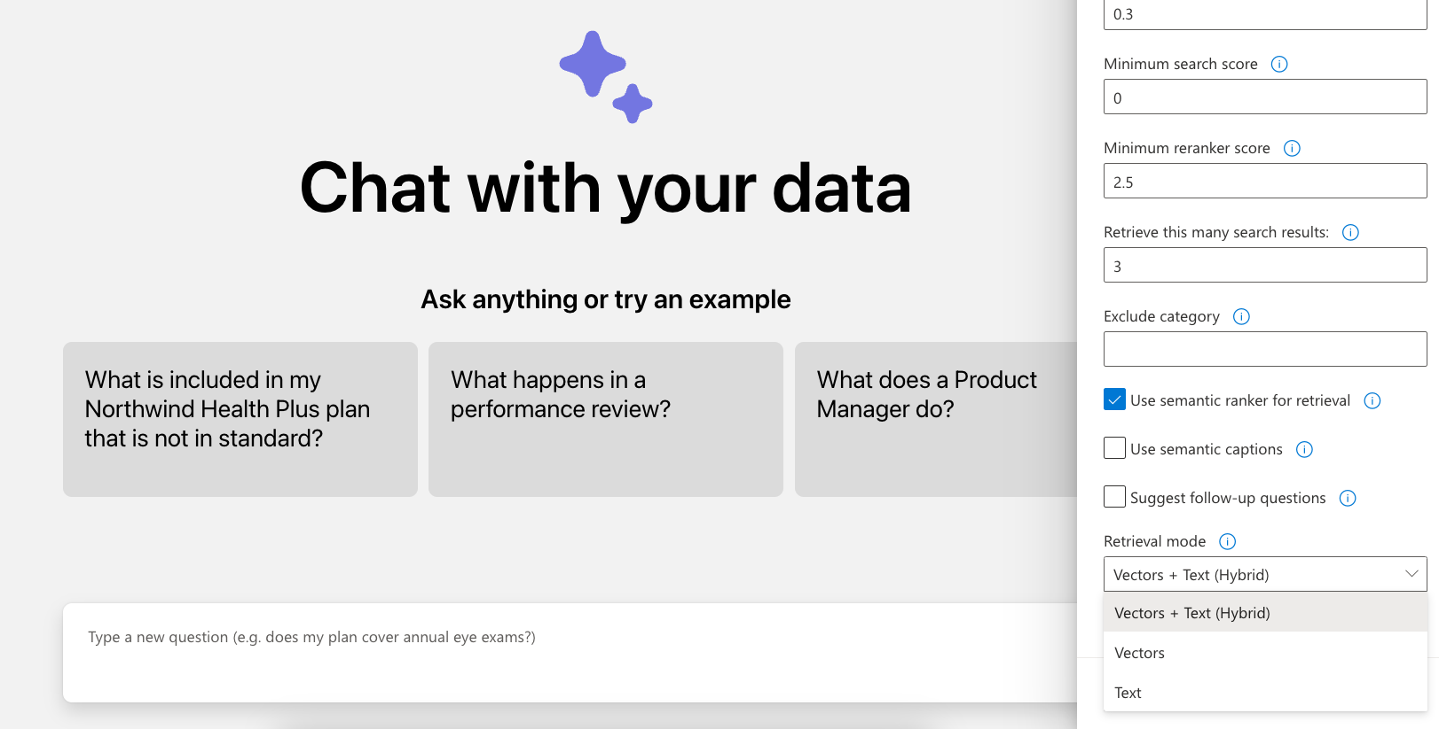
RAG search settings
Notes:
We've built all these search modes as settings in the open-source RAG solution, so that you can see for yourself the effect of different search options on your own data.

Slide 32
Data preparation
Notes:
The other crucial component of a RAG application is the data preparation, especially when you're building a RAG on top of unstructured documents.

Slide 33
Why do we need to split documents?
1
LLMs have limited context windows (4K – 128K)
2
When an LLM receives too much information, it can get easily distracted by irrelevant details.
Accuracy
Number of documents in input context
Source: Lost in the Middle: How Language Models Use Long Contexts, Liu et al. arXiv:2307.03172
Notes:
As I mentioned earlier, we typically need to split the documents before storing them in the AI Search index.
There are two reasons for splitting the documents:
First, LLMs typically have limited context windows, where a context window is the maximum amount of tokens you're allowed to send to it. The original OpenAI models had context windows of 4-8 thousand, but the newer models are around 128,000 tokens, which is fairly large.
Second, even if your document technically fits in the context window, you risk confusing the LLM by distracting it with irrelevant details. There's a great research paper about this, called "Lost in the Middle", where they measured the accuracy of answers with increasing input sizes.

Slide 34
Optimal size of document chunk
Number of tokens
Chunk boundary strategy
Retrieval Configuration | Recall@50
512 input tokens per vector | 42.4
1024 input tokens per vector | 37.5
4096 input tokens per vector | 36.4
8191 input tokens per vector | 34.9
Chunk boundary strategy | Recall@50
512 tokens, break at token boundary | 40.9
512 tokens, preserve sentence boundaries | 42.4
512 tokens with 10% overlapping chunks | 43.1
512 tokens with 25% overlapping chunks | 43.9
A token is the unit of measurement for an LLM's input/output. ~1 token/word for English, higher ratios for other languages.
A chunking algorithm should also consider tables, and generally avoid splitting tables when possible.
Source: aka.ms/ragrelevance
🔗 aka.ms/genai-cjk
Notes:
The Azure AI Search team even did their own research to determine the optimal input size to send to LLMs. Here, you can see that they found the best recall with an input size of 512 tokens. They also researched the best strategy for splitting the chunks, and found the best recall when they preserved sentence boundaries and overlapped each chunk by 25%.

Slide 35




Data ingestion process
This is a typical ingestion process that can be highly customized to meet the domain needs:
Azure Blob Storage
Azure Document
Intelligence
Python
Azure OpenAI
Azure
AI Search
Upload documents
An online version of each document is necessary for clickable citations.
Extract data from documents
Supports PDF, HTML, docx, pptx, xlsx, images, plus can OCR when needed.
Local parsers also available for PDF, HTML, JSON, txt.
Split data into chunks
Split text based on sentence boundaries and token lengths.
Langchain splitters could also be used here.
Vectorize chunks
Compute embeddings using OpenAI embedding model of your choosing.
Indexing
Document index
Chunk index
Both
Notes:
So here is what a data ingestion process could look like.
First, we store the documents in Azure Blob Storage, so that we have a version of the file that can be rendered as a citation in the app.
Then, we extract the text from the documents, using Azure Document Intelligence or a local parser.
Next, we split the data into chunks based on optimal token length and sentence boundaries.
We take those chunks and compute embeddings for them using an embedding model, like the Azure OpenAI embedding models.
Finally, we store the text, embedding, and Blob storage link inside the Azure AI search index.
This whole data ingestion process can run as a Python script locally, and that's what we've done in our open source RAG solution.

Slide 36
Integrated vectorization
In preview
This built-in feature for Azure AI Search enables cloud-based data ingestion with built-in skills.
Data source access
Blob Storage
ADLSv2
SQL DB
CosmosDB
…
+ Incremental change tracking
File format cracking
PDFs
Office documents
JSON files
…
+ Extract images and text, OCR as needed
Chunking
Split text into passages
Propagate document metadata
Vectorization
Turn chunks into vectors
OpenAI embeddings or your custom model
Indexing
Document index
Chunk index
Both
🔗 https://learn.microsoft.com/azure/search/vector-search-integrated-vectorization
Notes:
Another option for data ingestion is to use integrated vectorization, a built-in feature for Azure AI Search that runs the entire process in the cloud, using built-in skills and indexers. That can hook into all of the AI Search supported data sources, like Blob Storage or SQL DB, but it may be a bit trickier to customize if the built-in skills aren't meeting your needs. Try it out and give us your feedback!

Slide 37
Evaluation
Notes:
Before we put our RAG app into production, we need to run evaluations to make sure the answers are high enough quality.

Slide 38
Are the answers high quality?
Are they clear and understandable?
Are they correct? (relative to the knowledge base)
Are they formatted in the desired manner?
Yes, according to the information provided in the PerksPlus.pdf document, underwater activities such as scuba diving are covered under the program.
Do the perks cover underwater activities?
Yes, the perks provided by the PerksPlus Health and Wellness Reimbursement Program cover a wide range of fitness activities, including underwater activities such as scuba diving. The program aims to support employees' physical health and overall well-being, so it includes various lessons and experiences that promote health and wellness. Scuba diving lessons are specifically mentioned as one of the activities covered under PerksPlus. Therefore, if an employee wishes to pursue scuba diving as a fitness-related activity, they can expense it through the PerksPlus program.
Yes, underwater activities are included as part of the PerksPlus program. Some of the underwater activities covered under PerksPlus include scuba diving lessons [PerksPlus.pdf#page=3].
Notes:
For a RAG app, a high quality answer must be clear, correct, and formatted correctly. Most answers from LLMs are clear, but they may not always be accurate according to your domain, and they may not be formatted the way your app expects. For example, the first two answers are correct, but only the third answer here contains a properly formatted citation.

Slide 39
What affects the quality?
Large Language Model
Question
Search
Search engine (ie. Azure AI Search)
Search query cleaning
Search options (hybrid, vector, reranker)
Additional search options
Data chunk size and overlap
Number of results returned
System prompt
Language
Message history
Model (ie. GPT 3.5)
Temperature (0-1)
Max tokens
Notes:
There are so many factors that affect the answer quality, since there are multiple steps in the RAG process with their own parameters. We've already discussed that many factors affect the search results. There are also many options for the LLM steps that we use, like what model we use, what prompt we send in, what temperature we set, and more.

Slide 40
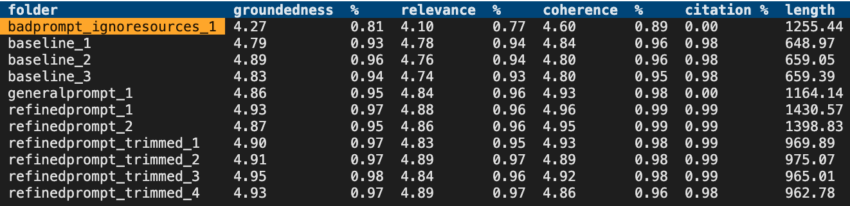
Evaluation approaches
Evaluate the retrieval system
Recall, precision, NDCG/MAP
aka.ms/ragrelevance
Evaluate language models
Shifting space, many metrics, consider your task.
chat.lmsys.org/?leaderboard
Evaluate the full RAG stack for quality and safety
AI Studio or promptflow-evals for GPT-based evaluations and metrics→ At Build: BRK107:
aka.ms/ragchat/eval
Basic SKU now supports up to 3 partitions, up from a single partition
Limits are GB/partition
Notes:
You can start with the options that are the best according to research. Then, to ensure that they are working well for your particular use case, you need to run evaluations. You can evaluate the retrieval step and language models independently, but the most important evaluation is of the answers that come out of your app. You can use Azure AI Studio to run those evaluations in that portal, or use the PromptFlow evaluations SDK to run them from your code. Check out our evaluator repository for an evaluation flow that's optimized for RAG chat apps, and gives you command-line tools for reviewing the results.

Slide 41
Securing your RAG
Notes:
Now let's talk about security. If you're building an app for internal use in an enterprise, you want to ensure that it can only be accessed internally.

Slide 42
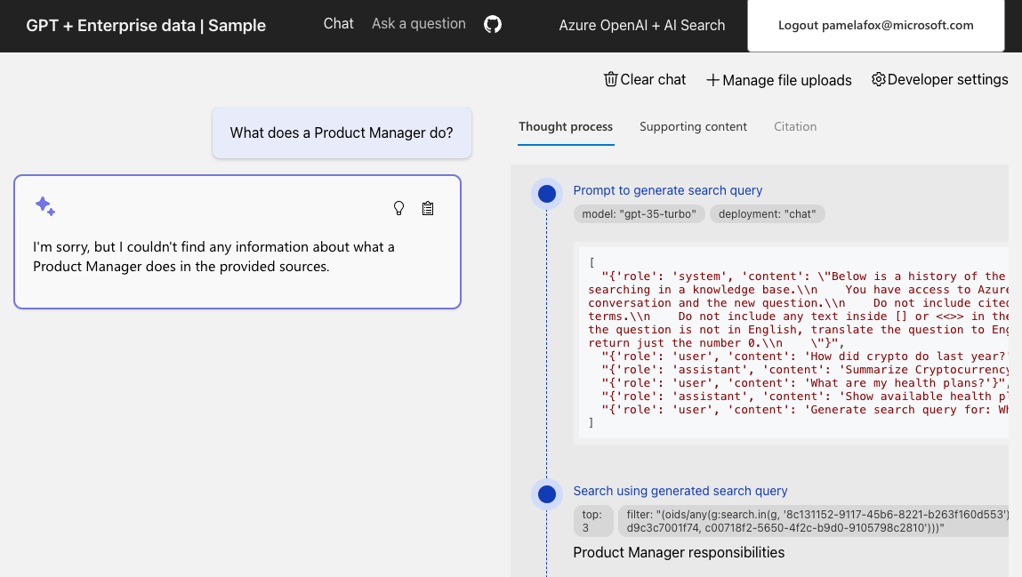
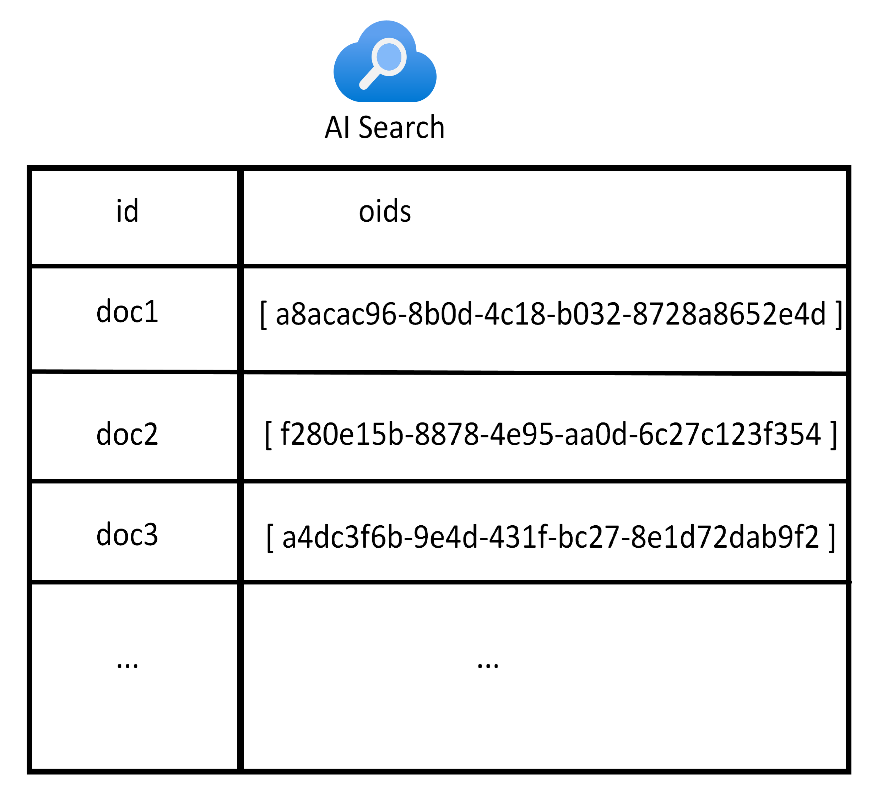
User login and data access control
aka.ms/ragchat/acl
Search index includes fields for oid and groups from Microsoft Entra:
Notes:
One way to secure your RAG app is to add user login to the app, to enforce that only users from your organization can login. When you enable this option, you can also allow the users to upload documents for their own personal search needs, and enforce data access controls in the search filter.

Slide 43
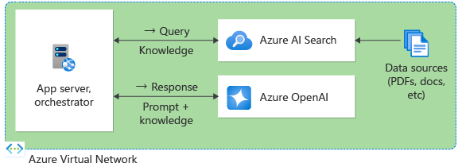
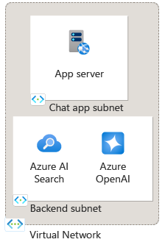
Private network deployment
Put all resources in a virtual network:
Use subnets for further isolation:
Notes:
Another way to ensure internal access is to deploy it to a virtual network, with all the services available via private endpoints, and access only from inside the virtual network.

Slide 44
Conclusion
Notes:
Let's wrap things up!

Slide 45
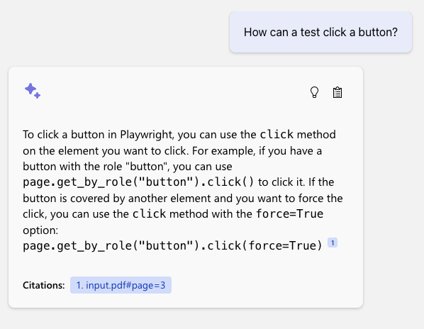





Example uses
Developers have used Azure AI search to create RAG apps for…
Public government data
Internal HR documents, company meetings, presentations
Customer support requests and call transcripts
Technical documentation and issue trackers
Product manuals
Customer Story: PwC scales GenAI for enterprise with Microsoft Azure AI
Notes:
We've seen thousands of developers deploy this app for a wide number of use cases, like internal HR help, customer sales help chatbots, product manuals, and more.

Slide 46
Next steps
1
Learn more about Azure AI Search
aka.ms/AzureAISearch
Dig more into quality evaluation details and why Azure AI Search will make your application generate better results
aka.ms/ragrelevance
2
3
Deploy a RAG chat application for your organization’s data aka.ms/azai/python
4
Explore Azure AI Studio for a complete RAG development experience aka.ms/AzureAIStudio
Notes:
If you want to get started, check out our documentation, our research, and our open-source end-to-end RAG solution.

Slide 47
Efficient vector storage: Quantization
Store more vectors with less space using quantization
Scalar quantization from float32 to int8:
Model | Search Quality MIRACL (Semantic Search on 18 languages, nDCG@10, higher=better)
Cohere Embed v3
Embed v3 | 66.3
Embed v3 – int8 | 66.1
Embed v3 - binary | 62.8
Min float
Max float
~Min observed value
~Max observed value
-127
128
Binary quantization to a single bit:
Example:
1
Pick a center value C based on a sample or offline knowledge
Cohere v3 embeddings, 62.8 vs 66.3 → 94.7% original performance preserved
2
If >= C, it’s a 1, otherwise it’s a 0
3
Repeat for each dimension
Source: https://cohere.com/blog/int8-binary-embeddings
0
1
Notes:
First, let's talk about scale. If you're building a RAG app on a huge document store, then you'll find yourself storing a large number of vector embeddings. Azure AI Search now offers multiple ways to reduce your storage size, so that you can reduce your costs. One approach is quantization, which lets you reduce the floating point numbers to 8-bit integers or even to single bits. According to our studies, you can still achieve high recall while reducing your storage by a mangitude of 32x.
BRK108 - RAG at scale.pptx

Slide 48




Azure AI Search: Enterprise-ready
Including option for customer-managed encryption keys
Data Encryption
Secure Authentication
Managed identity and RBAC support
Network Isolation
Private endpoints, virtual networks
Extensive certifications across finance, healthcare, government, etc.
Compliance Certifications
Notes:
Like all Azure services, Azure AI Search offers all this..
Things like multiple options for data encryption, authentication, including managed identities, my favorite way of not having to deal with API keys, network isolation, and extensive compliance certifications are all part of this offering. All of these things are checked off from the very beginning as you're building solutions for this space.

Slide 49
Improving Retrieval in Large Datasets
“Hi HRBot, I’m based in the US, does my health plan cover annual eyesight checks?”
→
filter=category eq 'healthcare' and region eq 'US'
search=annual eyesight check coverage
vectorQueries=[…]
Filtering the dataset is highly impactful
Quality: focus on subset of data that’s known to matter
Performance: reduce recall set size
How can you subset a dataset with discrete filters?
Query classification by intent, topic, language, etc.
Filter extraction from context/history
Azure AI Search high-performance filters work with keyword, vector, and hybrid search
Multi-tenant scenarios
Special case of filters, data is a set partition
Consider whether you want vector indexes, brute-force search, or both

Slide 50
Robust retrieval for RAG apps
Responses only as good as retrieved data
Keyword search recall challenges
“vocabulary gap”
Gets worse with natural language questions
Vector-based retrieval finds documents by semantic similarity
Robust to variation in how concepts are articulated (word choices, morphology, specificity, etc.)
Example
Question:
“Looking for lessons on underwater activities”
Won’t match:
“Scuba classes”
“Snorkeling group sessions”
Notes:
RAG is only as good as the retrieval and that depends on the data you have and how simple it is to search.
If you’re used to search engines, you’re familiar with keyword search.
In the example. “underwater activities” would not return Scuba or Snorkeling.
Vector-based retrieval does semantic similarity. It would know those terms are semantically similar.

Slide 51
Announcement slide (dark) with color rotation
Announcing
Increased Vector, Storage, Compute Capacity
Same workloads can be handled with smaller tiers
Build billion-vector search services
Includes all the power of a full retrieval system
Details
Up to 12x increase in vector density increase
Up to 6x total storage limit increase
More compute capacity in most tiers
Applies to newly created services

Slide 52
New Expanded Capacity
SKU | Previous vector limit | New vector limit | Previous storage limit | New storage limit | Previous max service size | New max Service size
Basic | 1 | 5 (5x) | 2 | 15 (7.5x) | 2 GB | 45 GB
S1 | 3 | 35 (11.5x) | 25 | 160 (6.4x) | 300 GB | 1.88 TB
S2 | 12 | 150 (12.5x) | 100 | 512 (5x) | 1.2 TB | 6 TB
S3 | 36 | 300 (8.3x) | 200 | 1024 (5x) | 2.4 TB | 12 TB
L1 | 12 | 150 (12.5x) | 1024 | 2048 (2x) | 12 TB | 24 TB
L2 | 36 | 300 (8.3x) | 2048 | 4096 (2x) | 24 TB | 48 TB
Basic SKU now supports up to 3 partitions, up from a single partition
Limits are GB/partition

